Slide 1
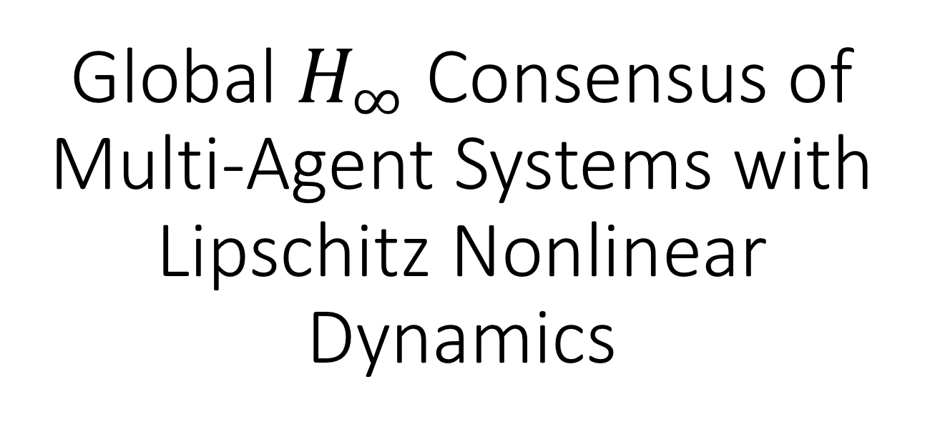
Global $H_{∞}$ Consensus of Multi-Agent Systems with Lipschitz Nonlinear Dynamics
Authors: Zhongkui Li, Xiangdong Liu, Mengyin Fu, Lihua Xie
Presented by Akhil Shah

Slide 2
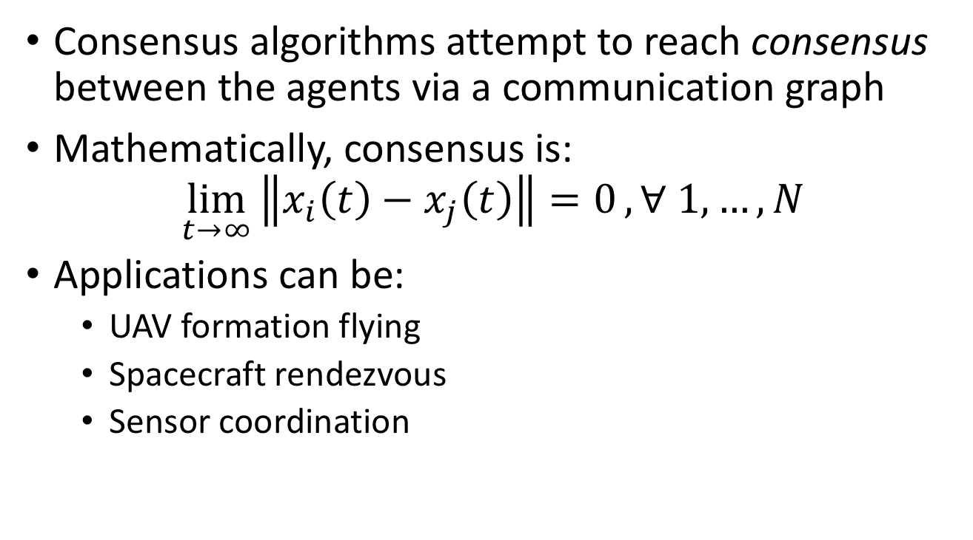
What is Consensus?
Consensus algorithms attempt to reach consensus between the agents via a communication graph
Mathematically, consensus is:
$$\lim_{t→∞}\left\|x_{i}\left(t\right)−x_{j}\left(t\right)\right\|{=0}, ∀ 1, …,N$$
Applications can be:
UAV formation flying
Spacecraft rendezvous
Sensor coordination

Slide 3
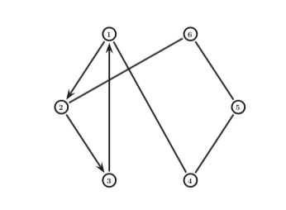
Communication Graph
Each agent does not have knowledge of every other agent
Due to bandwidth and/or latency issues
Adjacent agents can share information

Slide 4
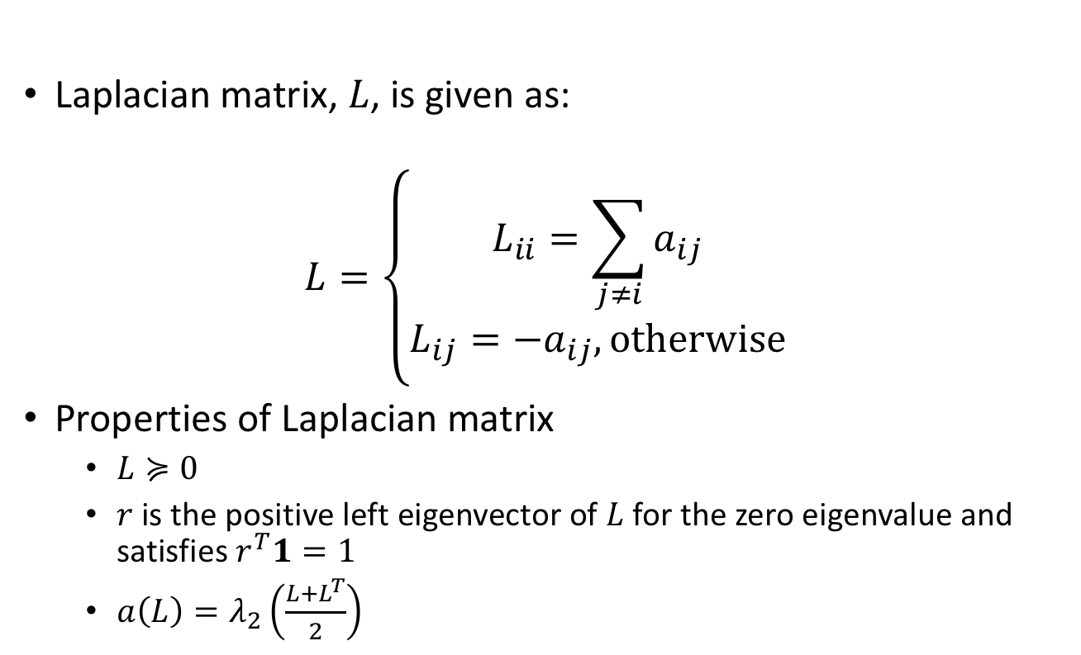
Laplacian Matrix
Laplacian matrix, $L$, is given as:
$$L=\left\{\begin{aligned}L_{ii}=\sum_{j≠i}{a_{ij}} \\ L_{ij}=−a_{ij}, \text{otherwise}\end{aligned}\right.$$
Properties of Laplacian matrix
$L≽0$
$r$ is the positive left eigenvector of $L$ for the zero eigenvalue and satisfies $r^{T}1=1$
$a\left(L\right)=λ_{2}\left(\frac{L+L^{T}}{2}\right)$

Slide 5
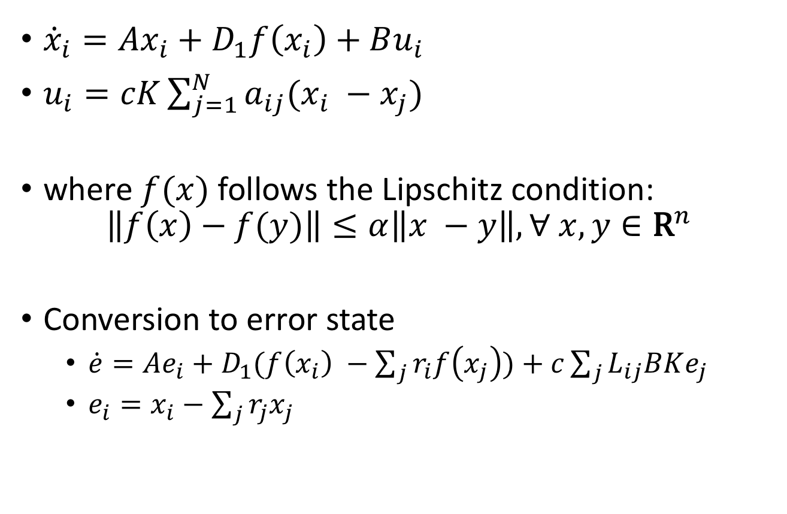
Dynamics w/o Disturbances
${\dot{x}}_{i}=Ax_{i}+D_{1}f\left(x_{i}\right)+Bu_{i}$
$u_{i}=cK\sum_{j=1}^{N}{a_{ij}(x_{i} −x_{j})}$
where $f(x)$ follows the Lipschitz condition:
$$\left\|f\left(x\right)−f(y)\right\|≤α\left\|x −y\right\|, ∀ x,y∈{\text{R}}^{n}$$
Conversion to error state
$\dot{e}=Ae_{i}+D_{1}(f\left(x_{i}\right) −\sum_{j}{r_{i}f\left(x_{j}\right))+c\sum_{j}{L_{ij}BKe_{j}}}$
$e_{i}=x_{i}−\sum_{j}{r_{j}x_{j}}$

Slide 6
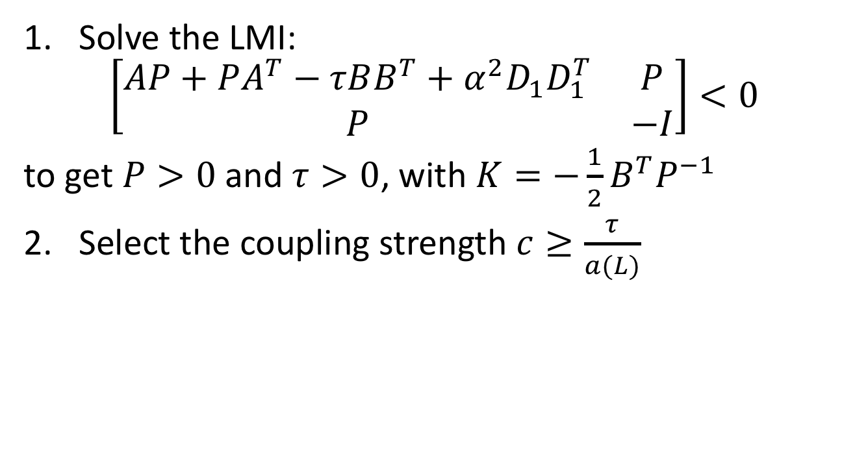
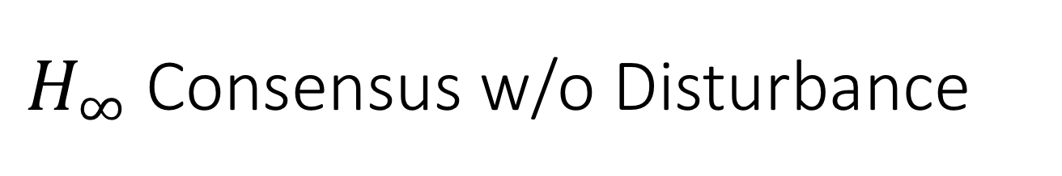
$H_{∞}$ Consensus w/o Disturbance
Solve the LMI:
$$\left[\begin{matrix}AP+PA^{T}−τBB^{T}+α^{2}D_{1}D_{1}^{T} & P \\ P & −I\end{matrix}\right]<0$$
to get $P>0$and $τ>0$, with $K=−\frac{1}{2}B^{T}P^{−1}$
2. Select the coupling strength $c≥\frac{τ}{a(L)}$

Slide 7
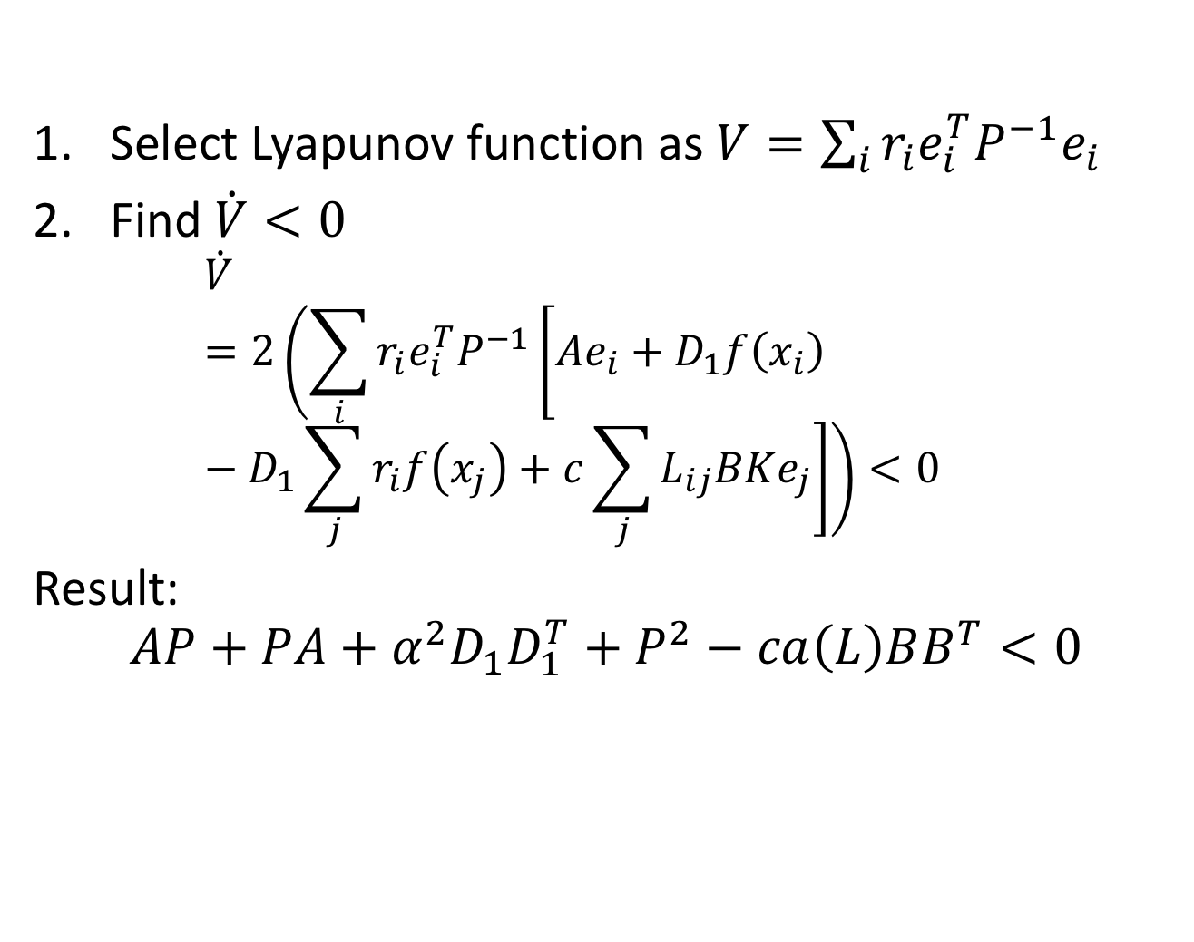
Sketch of Proof
Select Lyapunov function as $V=\sum_{i}{r_{i}e_{i}^{T}P^{−1}e_{i}}$
Find $\dot{V}<0$
$$\dot{V}=2\left(\sum_{i}{r_{i}e_{i}^{T}P^{−1}\left[Ae_{i}+D_{1}f\left(x_{i}\right) −D_{1}\sum_{j}{r_{i}f\left(x_{j}\right)+c\sum_{j}{L_{ij}BKe_{j}}}\right]}\right)<0$$
Result:
$$AP+PA+α^{2}D_{1}D_{1}^{T}+P^{2}−ca\left(L\right)BB^{T}<0$$

Slide 8
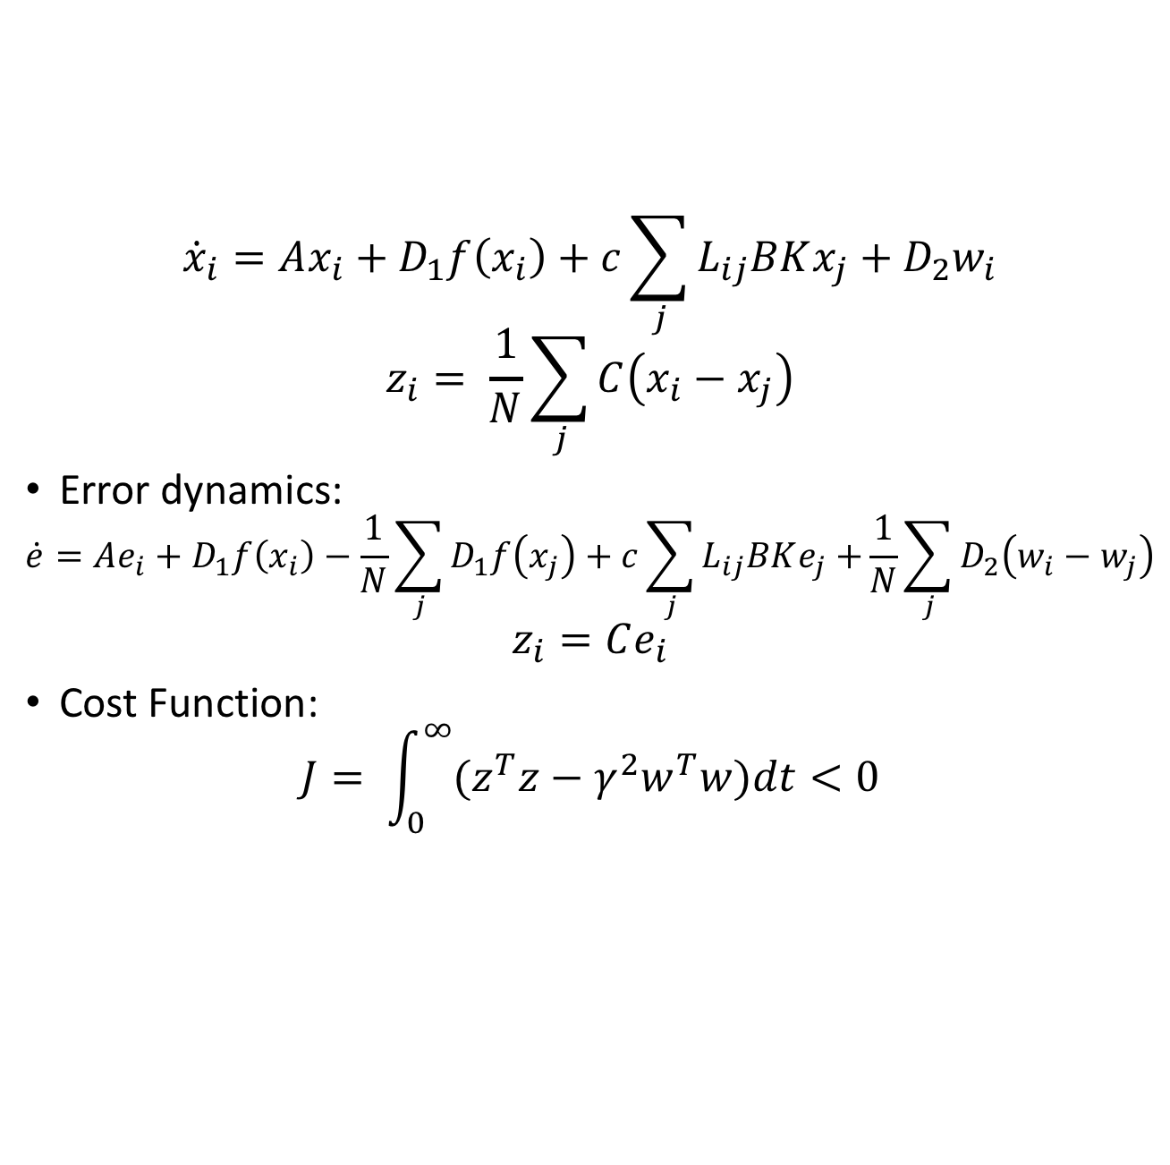
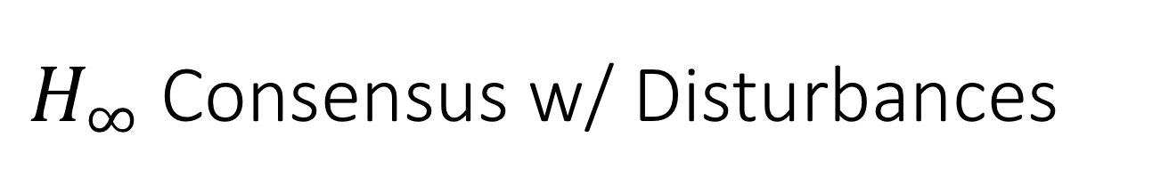
$H_{∞}$ Consensus w/ Disturbances
$${\dot{x}}_{i}=Ax_{i}+D_{1}f\left(x_{i}\right)+c\sum_{j}{L_{ij}BKx_{j}}+D_{2}w_{i}$$
$$z_{i}= \frac{1}{N}\sum_{j}{C\left(x_{i}−x_{j}\right)}$$
Error dynamics:
$$\dot{e}=Ae_{i}+D_{1}f\left(x_{i}\right)−\frac{1}{N}\sum_{j}{D_{1}f\left(x_{j}\right)+c\sum_{j}{L_{ij}BKe_{j}+}}\frac{1}{N}\sum_{j}{D_{2}\left(w_{i}−w_{j}\right)}$$
$$z_{i}=Ce_{i}$$
Cost Function:
$$J= \int_{0}^{∞}{{(z}^{T}z−γ^{2}w^{T}w)dt<0}$$

Slide 9
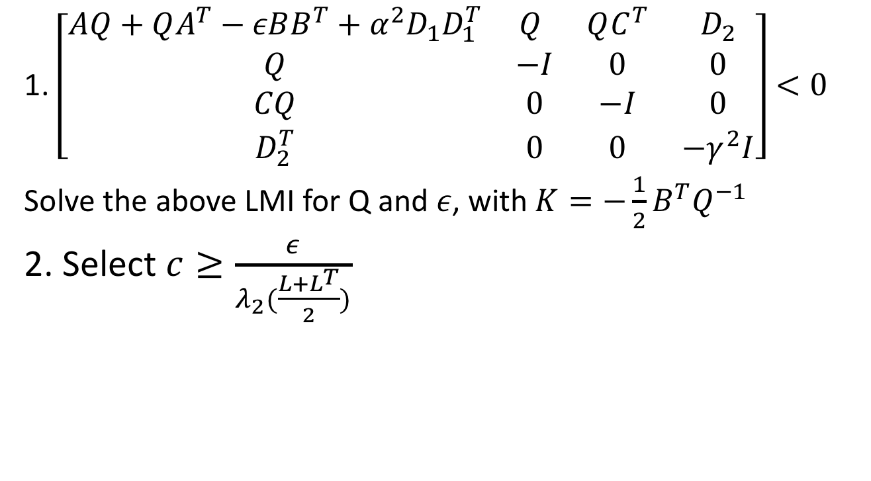
Algorithm 2
1. $\left[\begin{matrix}AQ+QA^{T}−εBB^{T}+α^{2}D_{1}D_{1}^{T} & Q & QC^{T} & D_{2} \\ Q & −I & 0 & 0 \\ CQ & 0 & −I & 0 \\ D_{2}^{T} & 0 & 0 & −γ^{2}I\end{matrix}\right]<0$
Solve the above LMI for Q and $ε$, with $K=−\frac{1}{2}B^{T}Q^{−1}$
2. Select $c≥\frac{ε}{λ_{2}(\frac{L+L^{T}}{2})}$

Slide 10
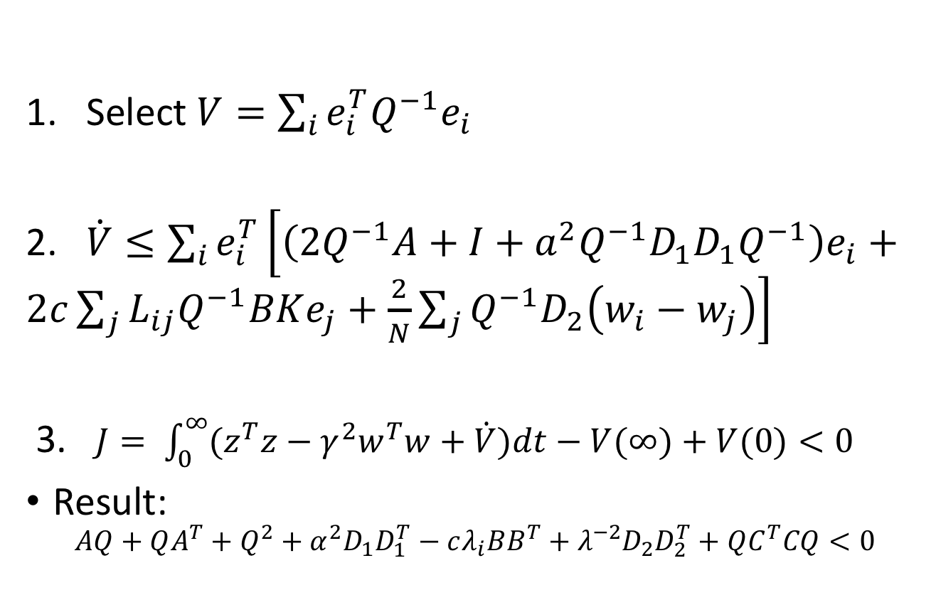
Sketch of Proof
Select $V=\sum_{i}{e_{i}^{T}Q^{−1}e_{i}}$
2. $\dot{V}≤\sum_{i}{e_{i}^{T}\left[\left(2Q^{−1}A+I+a^{2}Q^{−1}D_{1}D_{1}Q^{−1}\right)e_{i}+2c\sum_{j}{L_{ij}Q^{−1}BKe_{j}+\frac{2}{N}\sum_{j}{Q^{−1}D_{2}\left(w_{i}−w_{j}\right)}}\right]}$
3. $J= \int_{0}^{∞}{{(z}^{T}z−γ^{2}w^{T}w+\dot{V})dt−V(∞)+V(0)<0}$
Result:
$$AQ+QA^{T}+Q^{2}+α^{2}D_{1}D_{1}^{T}−cλ_{i}BB^{T}+λ^{−2}D_{2}D_{2}^{T}+QC^{T}CQ<0$$

Slide 11
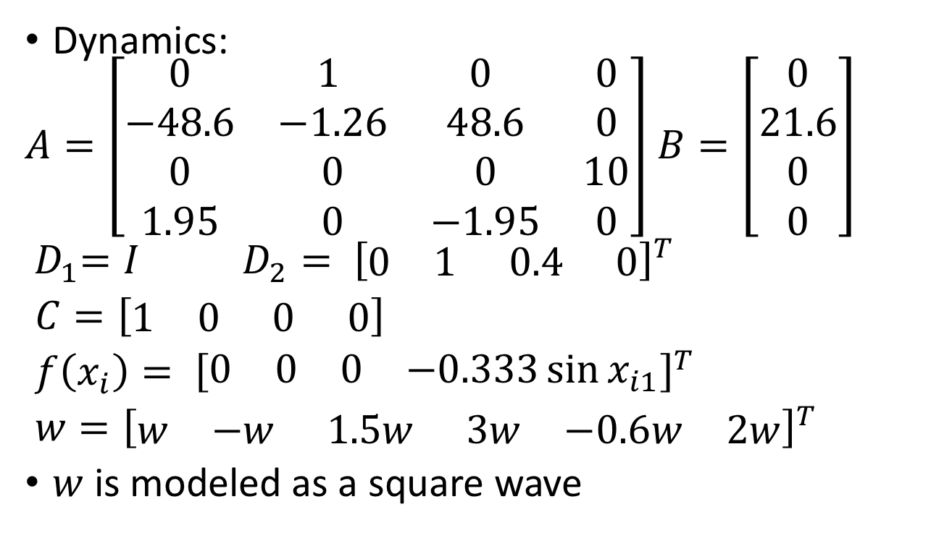
Consensus of 6 linked manipulators
Dynamics:
$A=\left[\begin{matrix}0 & 1 & 0 & 0 \\ −48.6 & −1.26 & 48.6 & 0 \\ 0 & 0 & 0 & 10 \\ 1.95 & 0 & −1.95 & 0\end{matrix}\right]$ $B=\left[\begin{aligned}0 \\ 21.6 \\ 0 \\ 0\end{aligned}\right]$
${ D}_{1}=I$ $D_{2}= {\left[\begin{matrix}0 & 1 & 0.4 & 0\end{matrix}\right]}^{T}$
$C=\left[\begin{matrix}1 & 0 & 0 & 0\end{matrix}\right]$
$f\left(x_{i}\right)= {\left[\begin{matrix}0 & 0 & 0 & −0.333\sin{x_{i1}}\end{matrix}\right]}^{T}$
$w={\left[\begin{matrix}w & −w & 1.5w & 3w & −0.6w & 2w\end{matrix}\right]}^{T}$
$w$ is modeled as a square wave

Slide 12
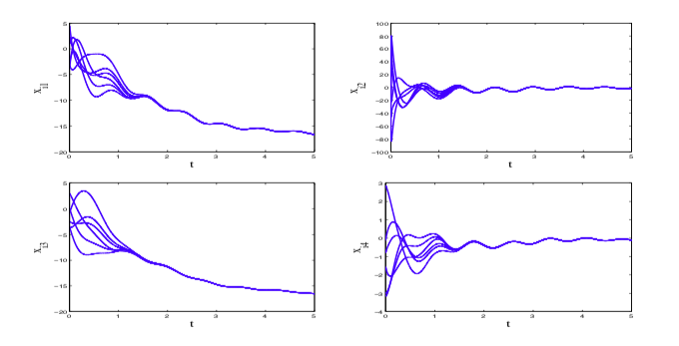

Results
With $γ=2$
$$K=\left[\begin{matrix}−2.4920 & −0.1957 & 1.4115 & −3.8216\end{matrix}\right]$$
$$c≥36.4462$$

Slide 13
Questions?

Slide 14
References
Li, Zhongkui, et. al. Global H_inf Consensus of Multi-Agent Systems with Lipschitz Non-linear Dynamics. ArXiv e-prints Feb. 2012.

